Slide 1
Modeling Oscillating Chemical Reactions
By: Asela Chandrasinghe

Slide 2
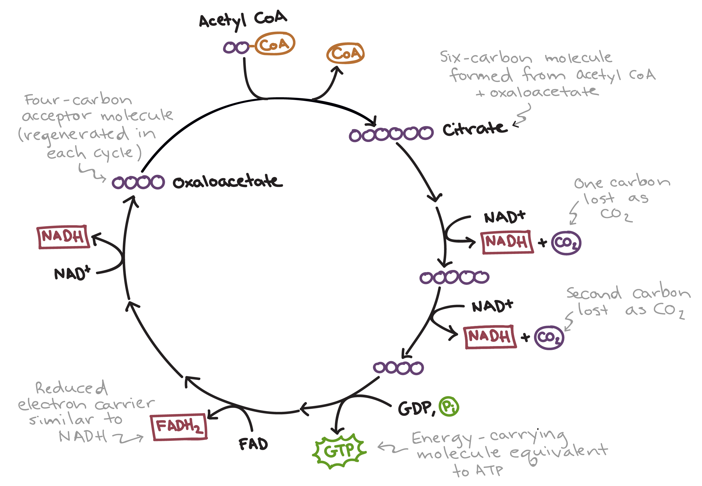
What is an Oscillating Chemical Reaction
Mixture of chemicals where concentrations of one or more compounds exhibit periodic changes
How does this obey laws of thermodynamics?
Has to be an open system
Far from equilibrium
Examples:
Belousov- Zhabotinsky reaction
Kreb’s cycle
Notes:
Pendulum: oscillate from side to side thorugh its equilibrium position- oscillations are attributed to interconversion between potential and kenetic energy.
Oscillating chemical reactions look like this but the 2nd law of thermodynamics state that once a reaction reaches equilibrium it can’t deviate from that spontaneously.
Grandfather Clock: hands of the clock go around repeatedly but the energy stored in elevation of weights decrease continuously
In oscillating chemical reaction. Concentrations of some components of the reaction mixture pass repeatedly through the same value but the energy releasing reaction that drives the oscillations proceeds continuously toward completion

Slide 3
Mechanism
Basics:
Mixture is far from equilibrium
Reaction follows at least 2 different pathways that switch between each other
Pathway 1 produces species consumed by pathway 2
What triggers switch between pathways

Slide 4
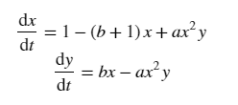
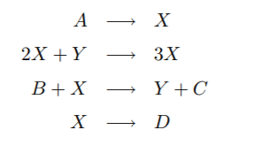
Modeling Oscillating Reaction- Brusselator
Notes:
Ohysisict Ilya Prigogine formulated this mathematical model for reactions like the BR which he called brusselator after his home town.

Slide 5
Brusselator- parameters
x = [x] (the concentration of chemical X in Molarity)
y = [y] (the concentration of chemical Y in Molarity)
t= time (in seconds)
a and b are positive constants
a has units of s⁻¹M⁻¹
b has units of s⁻¹
a and b are rate constants
Assume far from equilibrium
Notes:
A is second order
B is first order
Rate constant quantifies the rate of a reaction
Reaction orders can be determined only by experiment

Slide 6
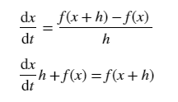

Euler’s Method and Brusselator- Boundary conditions
From t_ initial=0 to t_final = 50
N= 100,000
Number of steps between initial t to final t
$h=\frac{t_{inital}−t_{final}}{N}$
Size of each step

Slide 7
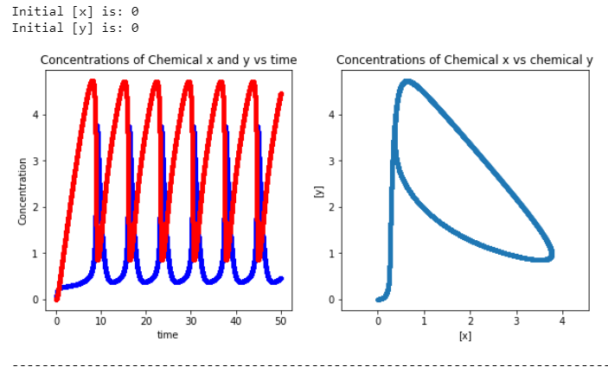
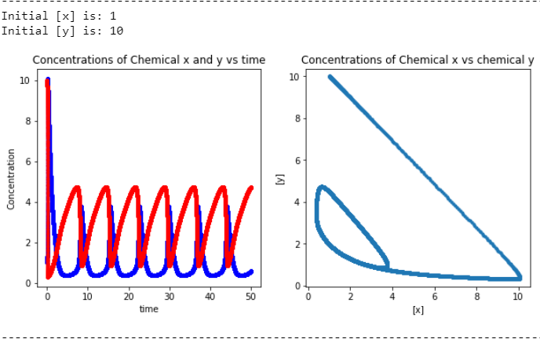
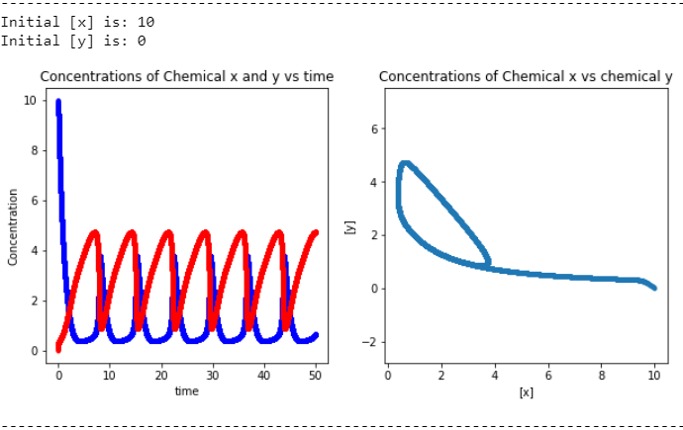
Brusselator- Changing Initial [x] and [y]
a =1
b = 3
Red = [x]
Blue = [y]

Slide 8
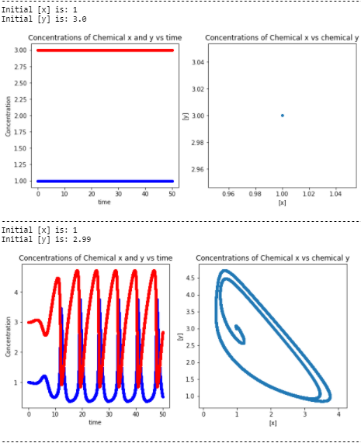
Point of Equilibrium
Equilibrium = rate of change is zero
Set dx/dt and dy/dt to 0
Solve for x and y
X=1 and y= b/a

Slide 9
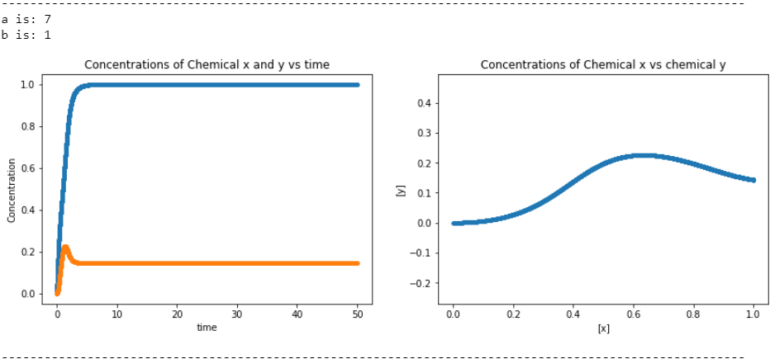
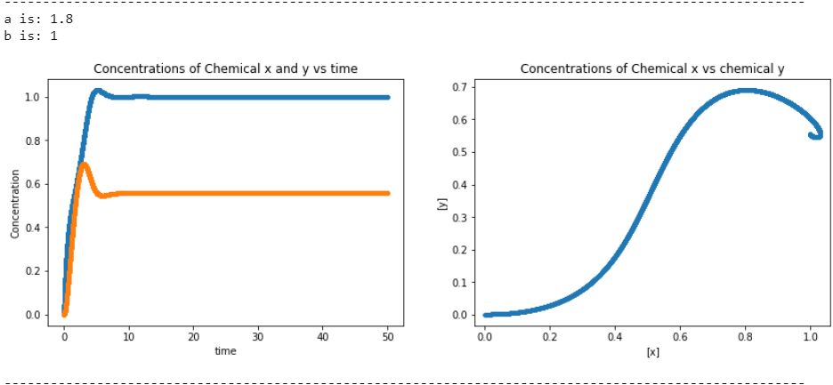
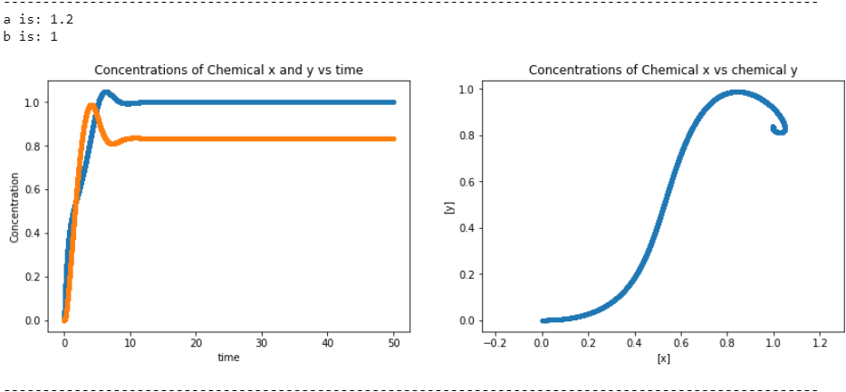
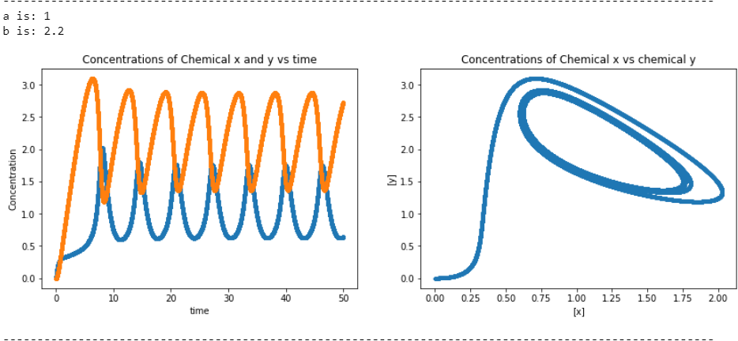
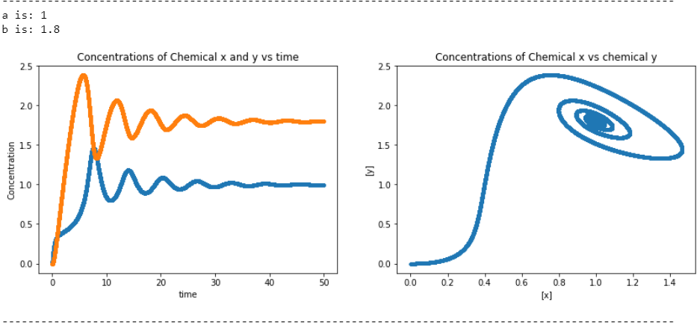
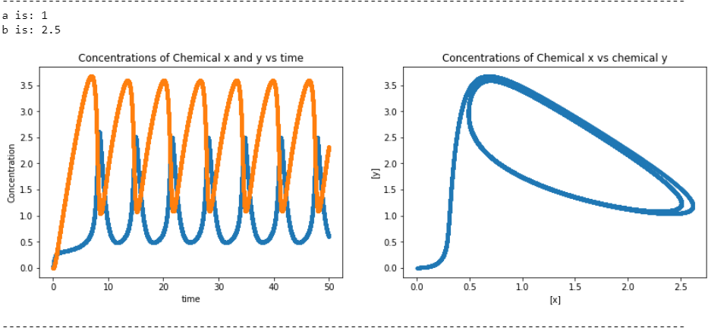
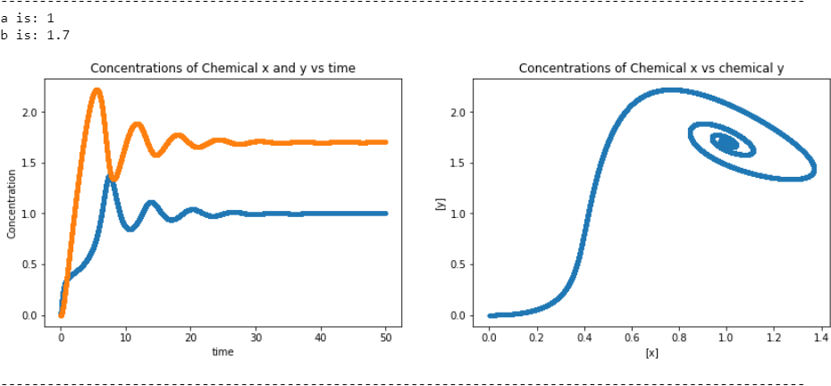
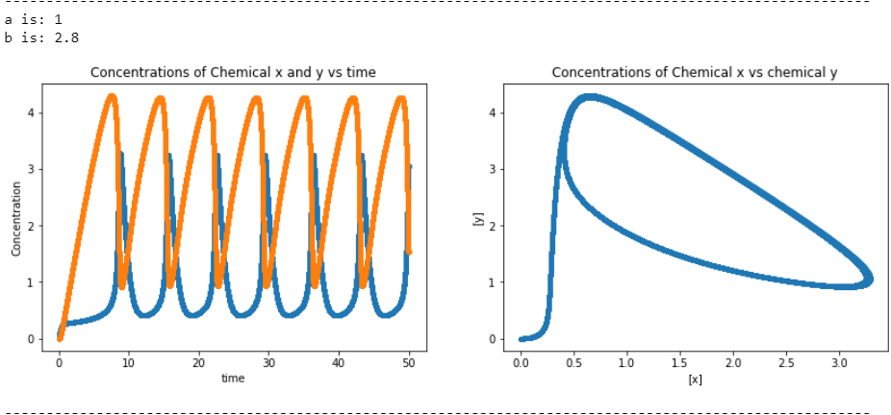
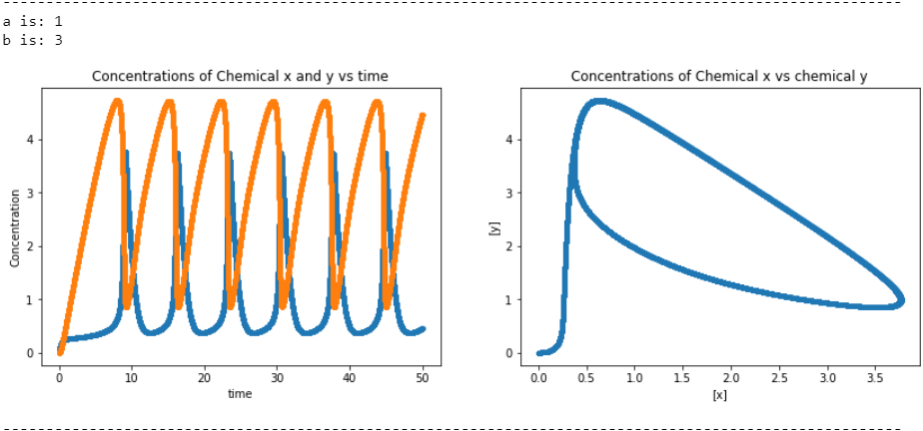
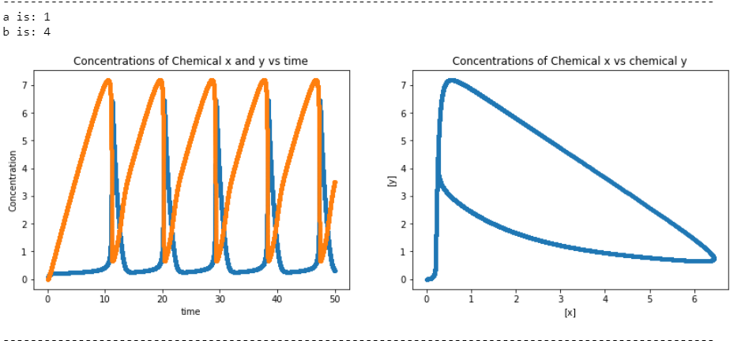
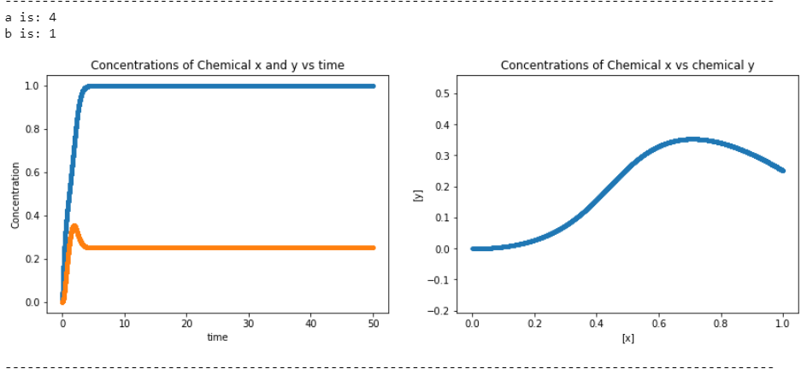
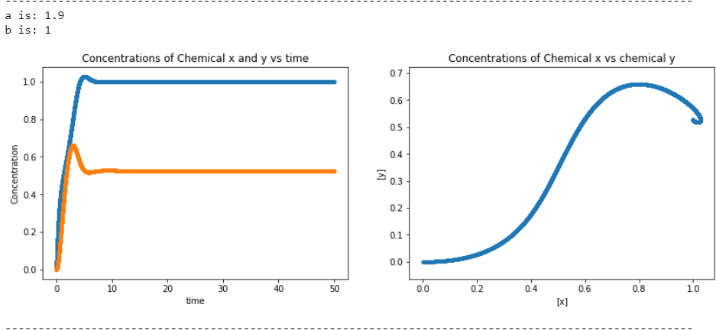
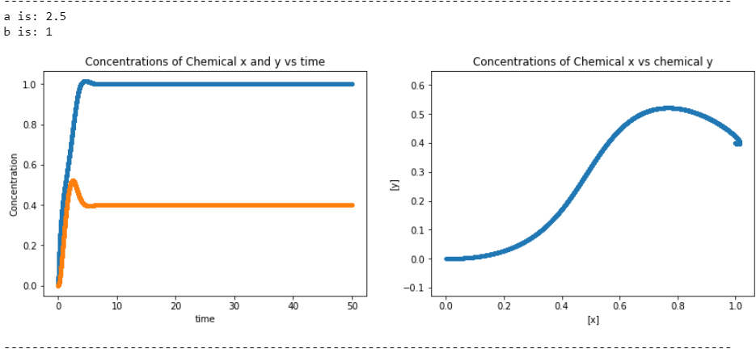
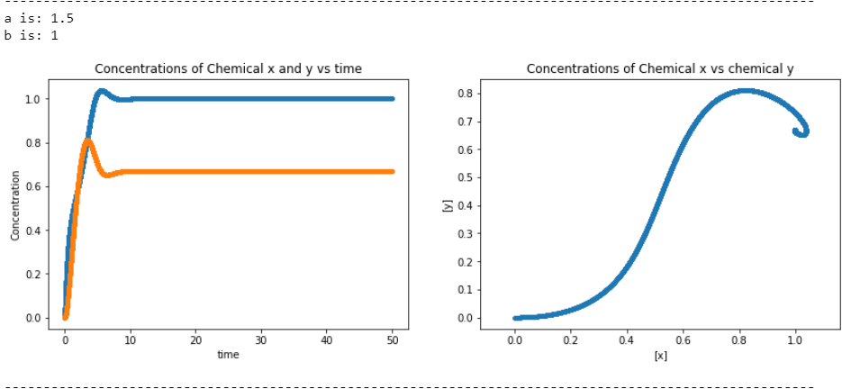
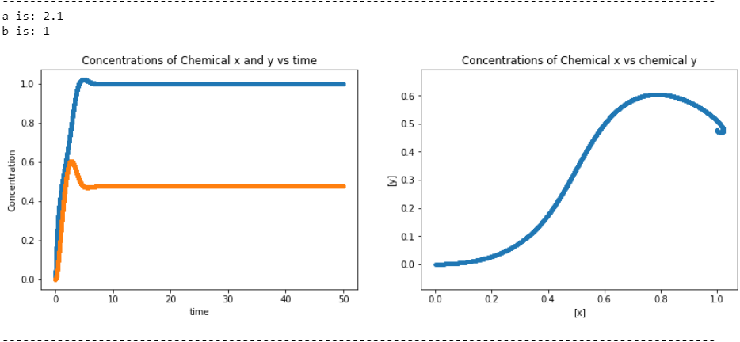
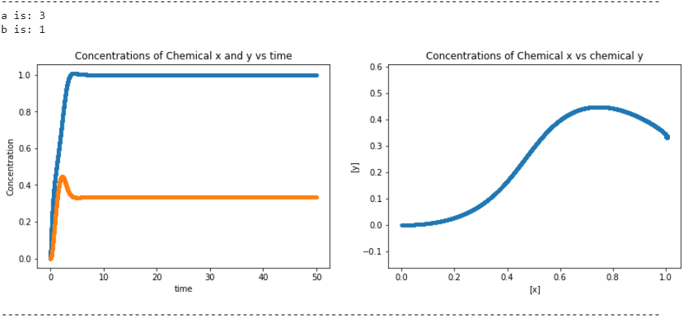
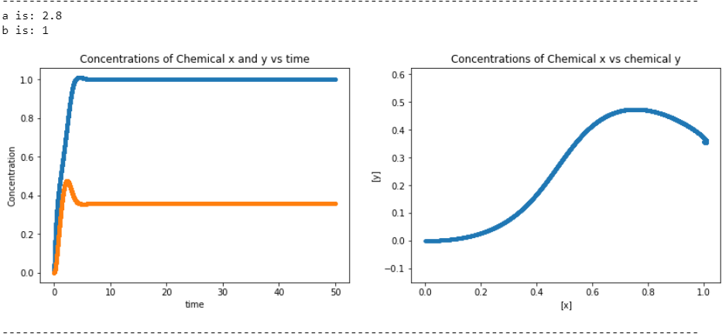

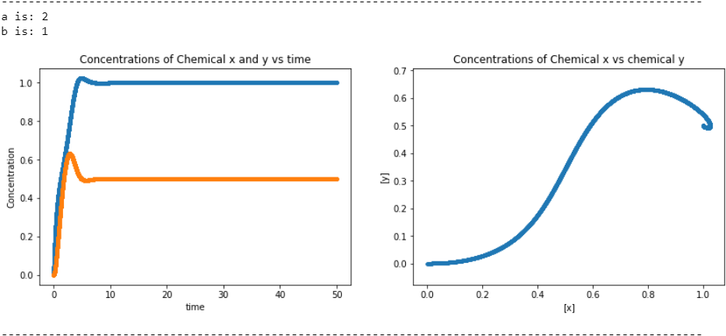
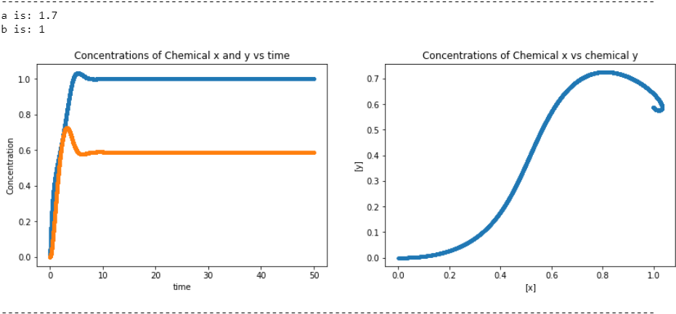
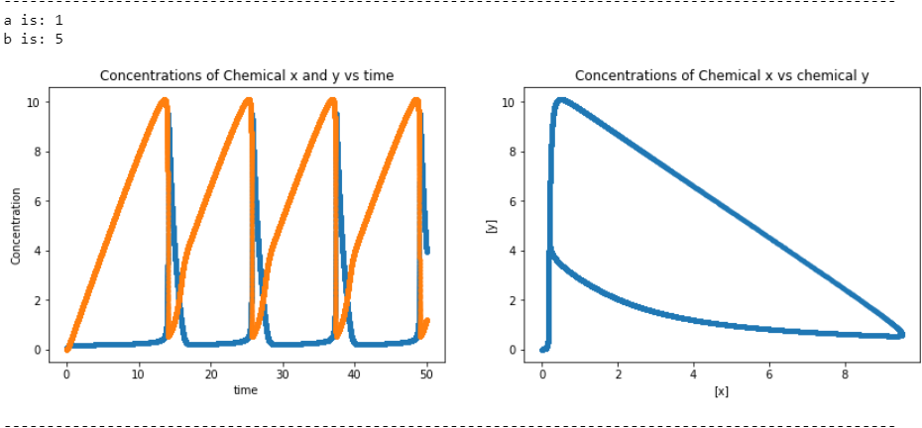
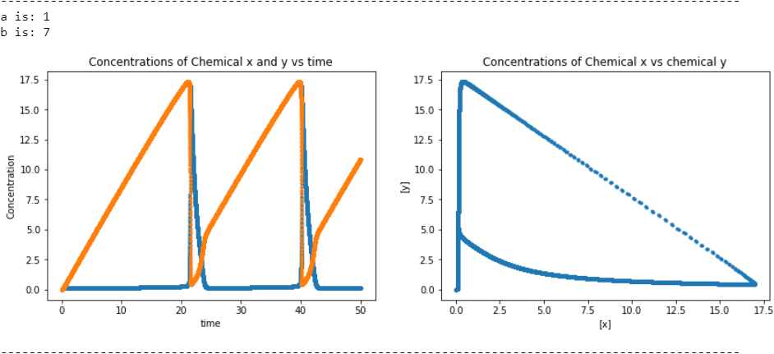
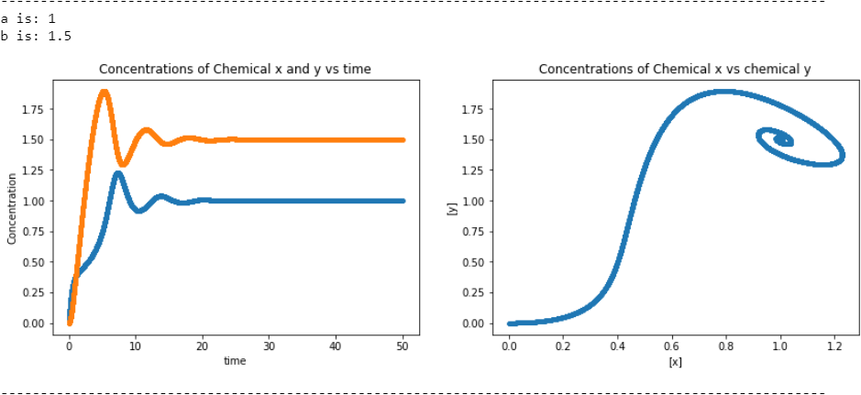
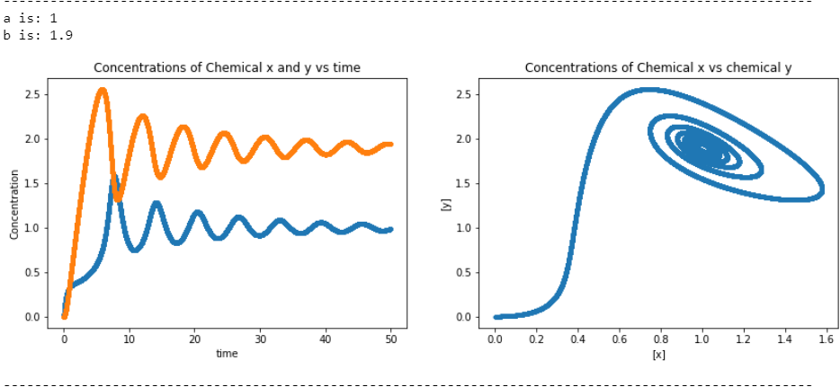
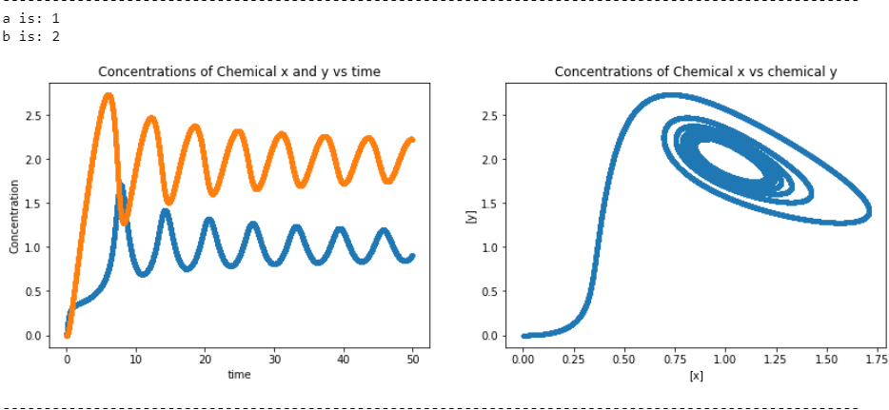
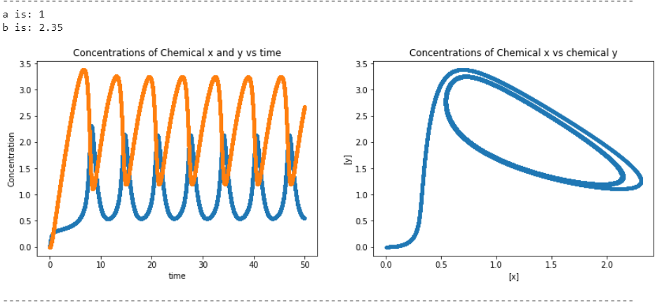
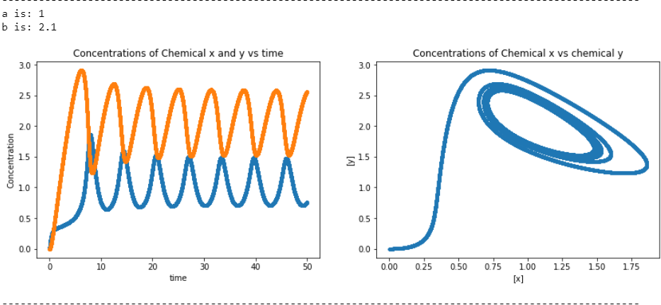
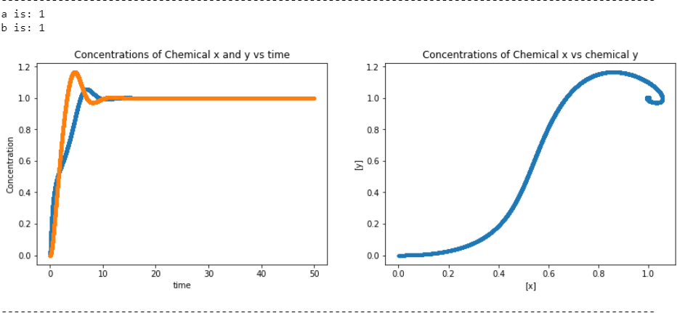
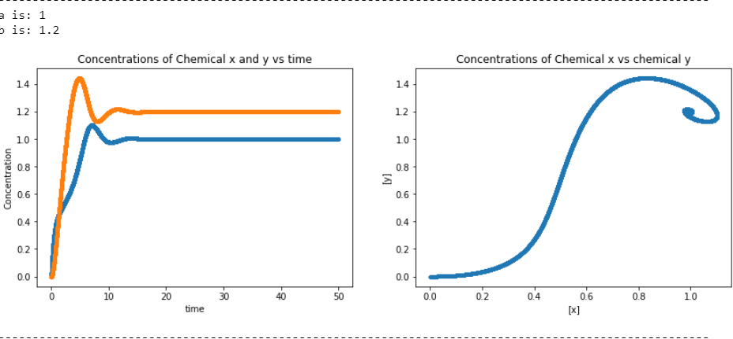
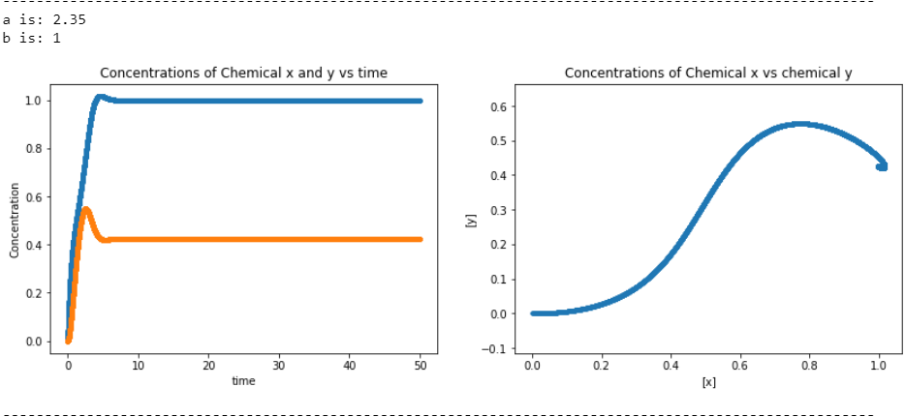
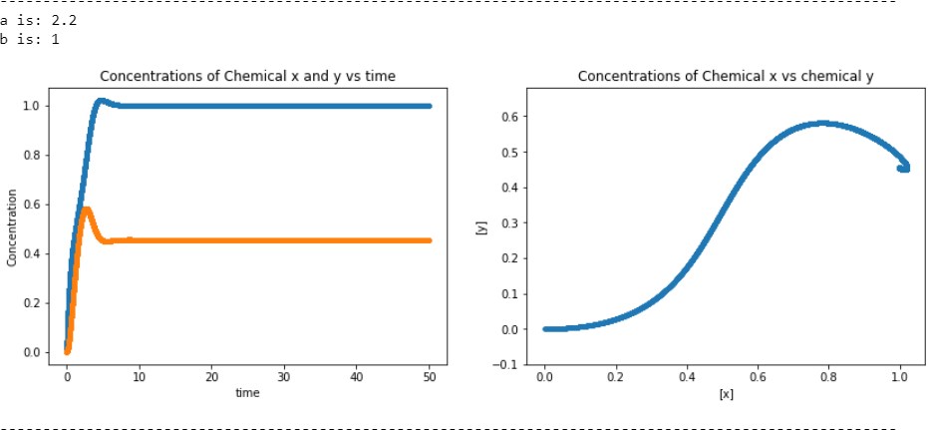
Brusselator- Changing a and b
— = [x]
— = [y]
Initial [x] = 0
Initial [y] = 0

Slide 10
How does the model Relate to the Belousov-Zhabotinsky (BZ) reaction
BZ reaction has a 7 step reaction mechanism
Cerium (IV) and cerium (III) are the key reactants that parallel chemical x and y (Shakhashiri, 1985)
Color changes are due to the different oxidation states of cerium
Different concentration change the reduction potential of system and cause oxidation/reduction of cerium
Steps of the mechanism are different order reactions that plays key role (Shakhashiri, 1985)

Slide 11
Image References
https://www.chem.wisc.edu/deptfiles/genchem/demonstrations/Gen_Chem_Pages/12kineticpage/briggs-rauscher_reaction.htm
https://www.khanacademy.org/science/biology/cellular-respiration-and-fermentation/pyruvate-oxidation-and-the-citric-acid-cycle/a/the-citric-acid-cycle

Slide 12
Work Cited
Shakhashiri, B. Z. Chemical demonstrations: A handbook for teachers of chemistry; Univ of Wisconsin Press: 1985; Vol. 2.

